Slide 1
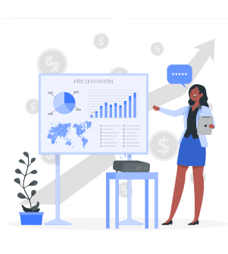
By-Rashi Bhardwaj(Batch 5)
Business Analyst Career Program - Capstone Project

Slide 2
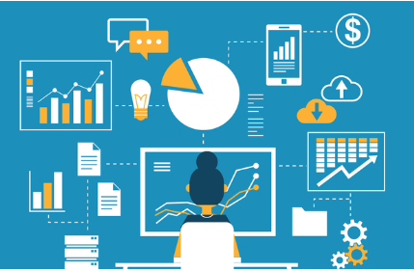
Data Exploration
It is data from an organization about the sales of premium bicycle brands. This data is crucial in understanding market position, identifying trends, and making an informed business decision.
This data allows us to track the sales of bicycle brands over time and gives us a clear understanding of bicycle brands’ popularity and market share.
Company is a bicycle manufacturing firm with six (6) brands of products and has five (5) Segments located across five (5) countries.
The 6 product are: Carretera, Montana, Paseo, Velo, VTT, Amarilla.
The 5 segments are Government, Midmarket, Channel Partners, Small Business and Enterprise.
This business operates in 5 different countries such as Canada, Germany, France, the United States of America and Mexico.
This data has 16 columns and 700 rows.

Slide 3
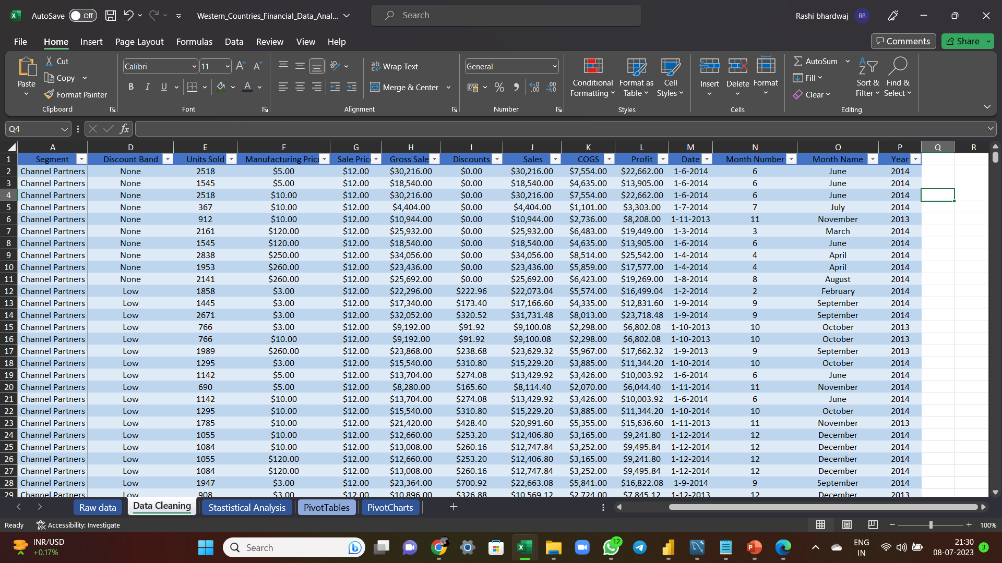
Data Exploration
I performed data cleaning techniques such as eliminating dash values, applying currency format, removing duplicates, and sorting the dataset. These steps improved data quality, consistency, and made it easier to analyze and identify patterns. The data cleansing process enhanced the effectiveness of analysis and generated valuable insights.

Slide 4
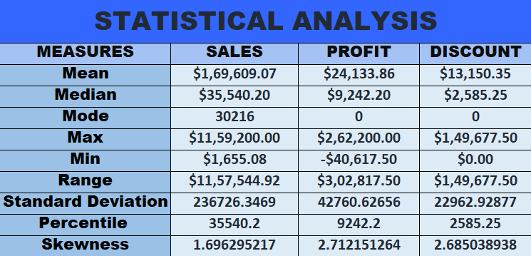
Statistical Analysis using Excel

Slide 5
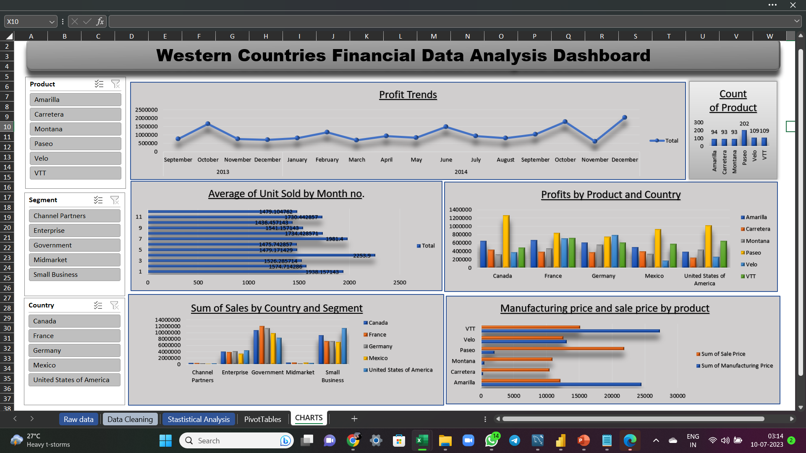
Graphical Analysis using Excel
I have created an interactive and visually appealing dashboard in Excel by incorporating six pivot tables along with three column charts, two bar charts, and a line chart. To enhance the user experience and facilitate data exploration, I have included three slicers for easy filtering and a better understanding of the data.

Slide 6
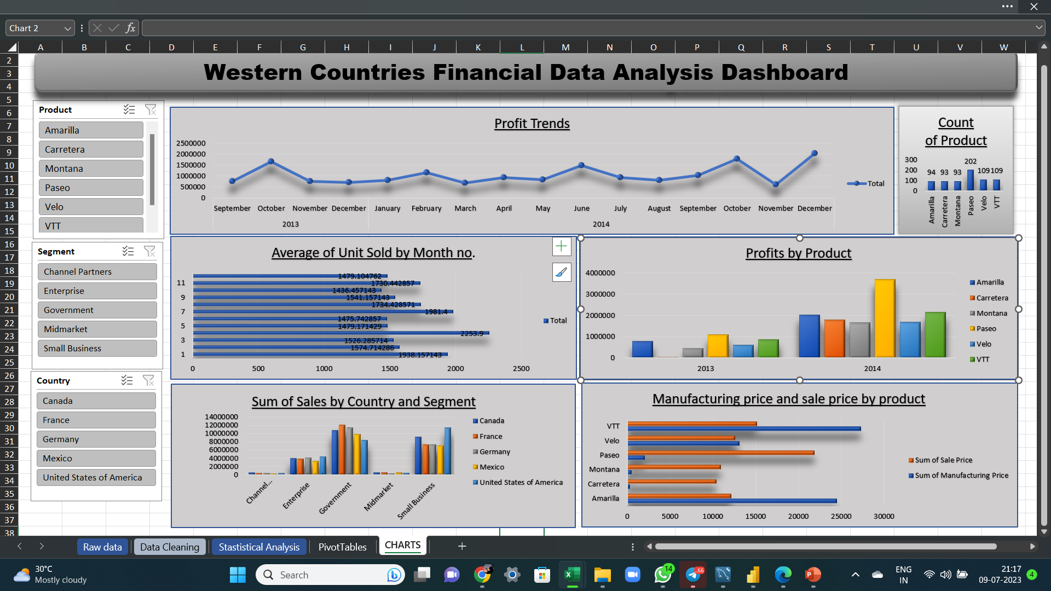
Graphical Analysis using Excel
The graph below shows the sum of profit for each product in different months and years.
It is evident that October and December have the highest profit compared to other months. The organization should focus on sales during these two months to generate maximum profit.
This graph on the left side shows the average number of units sold in different months.
According to the graph, the highest number of units is sold in the months of January, April, July, and November.

Slide 7
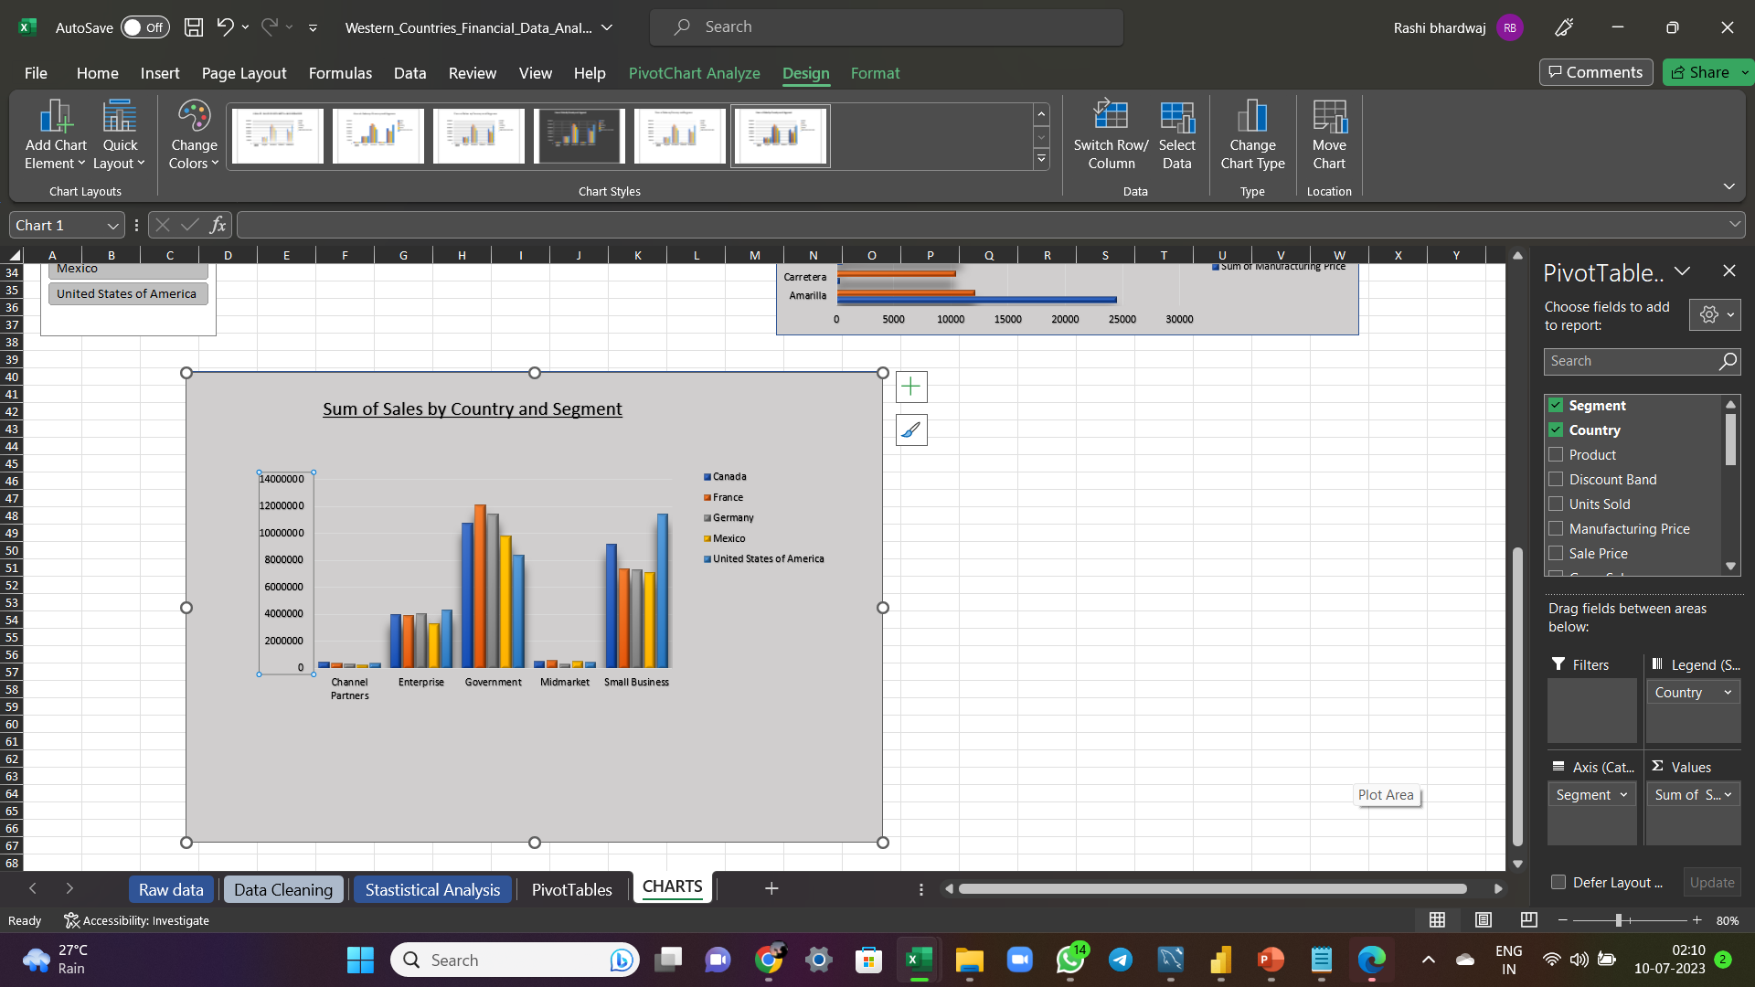
Graphical Analysis using Excel
The graph below displays the sum of sales by Country and Segment. It is evident that the government segment has the highest sales, while the Channel Partners and Midmarket segments have the lowest sales. Additionally, when examining the top two countries in terms of sales, the United States (USA) ranks first, followed by Canada in second place.

Slide 8
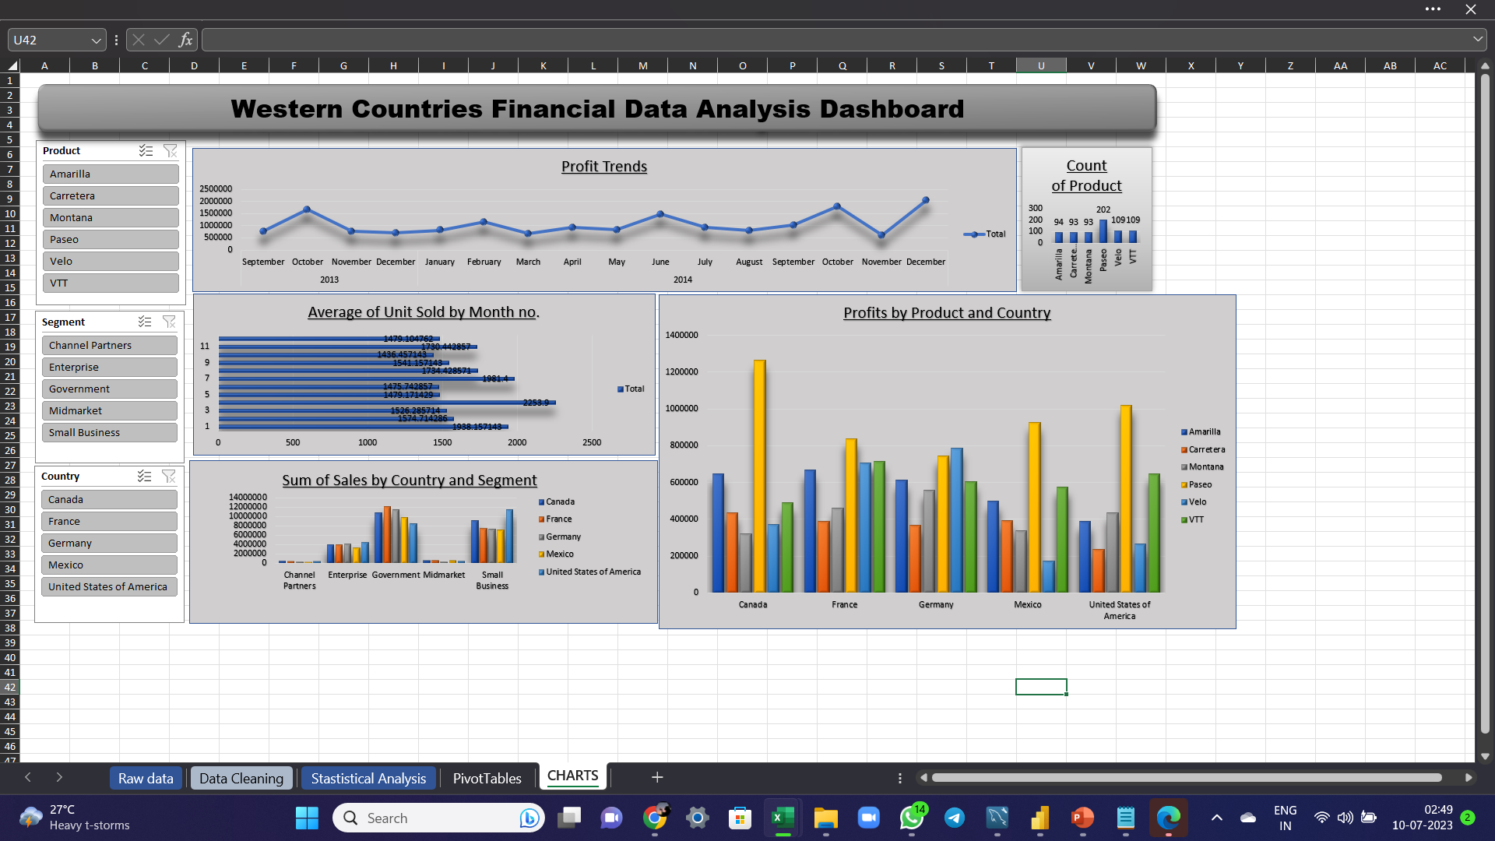
Graphical Analysis using Excel
The graph below illustrates the sum of profit for each product in each country of sale. It is evident that Paseo demonstrates the highest profit in Canada. Additionally, Paseo exhibits strong performance across all five countries.

Slide 9
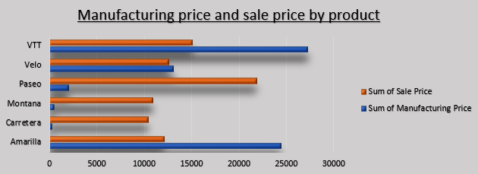
Graphical Analysis using Excel
The bar graph below illustrates the manufacturing price and sales price of the products. Notably, the Paseo brand stands out in terms of cost efficiency, as its manufacturing cost is significantly lower compared to its sales price. This advantage contributes to Paseo earning the highest profit among the brands.

Slide 10
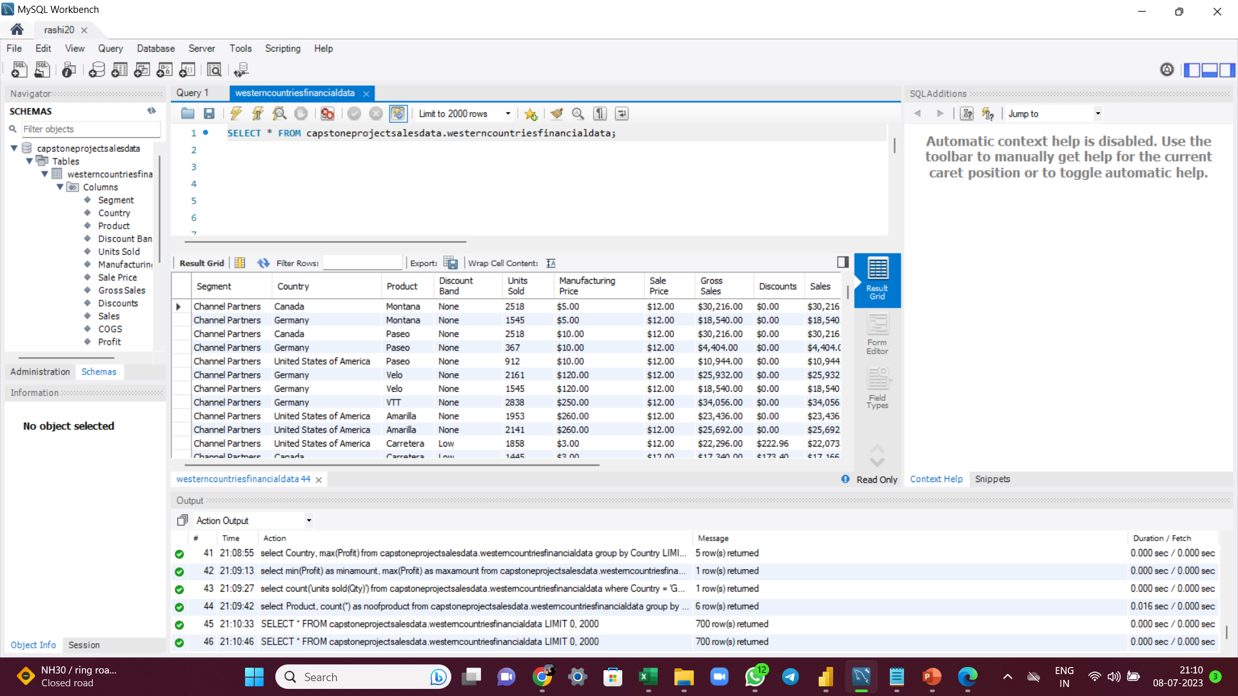
Insert the given data into the SQL server
The data has been successfully inserted in the SQL server as shown in the below screenshot with the table name westerncountriesfinancialdata.

Slide 11
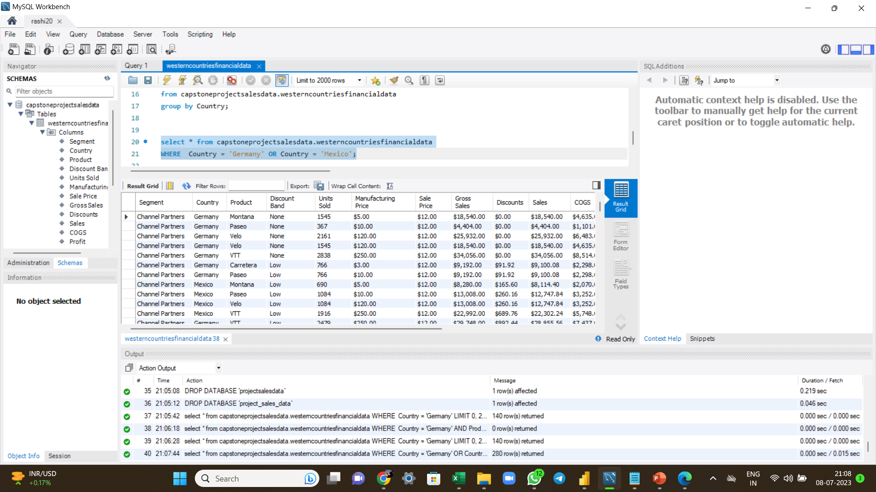
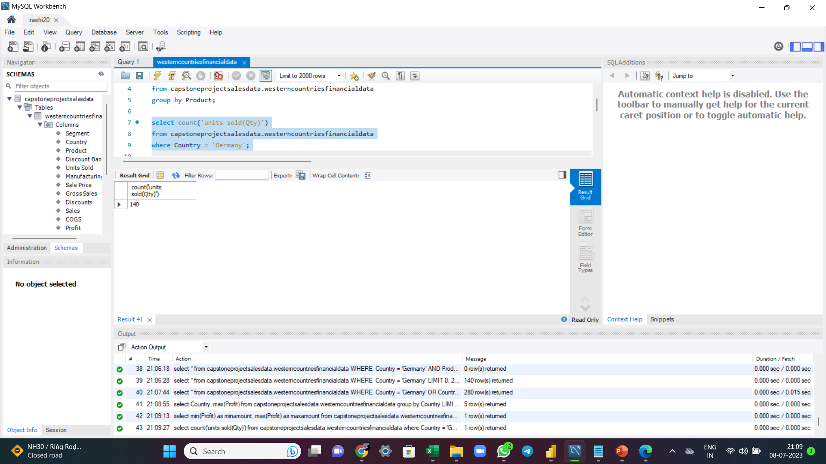
Verified the data by successfully performing a few queries

Slide 12

Queries(continued)

Slide 13
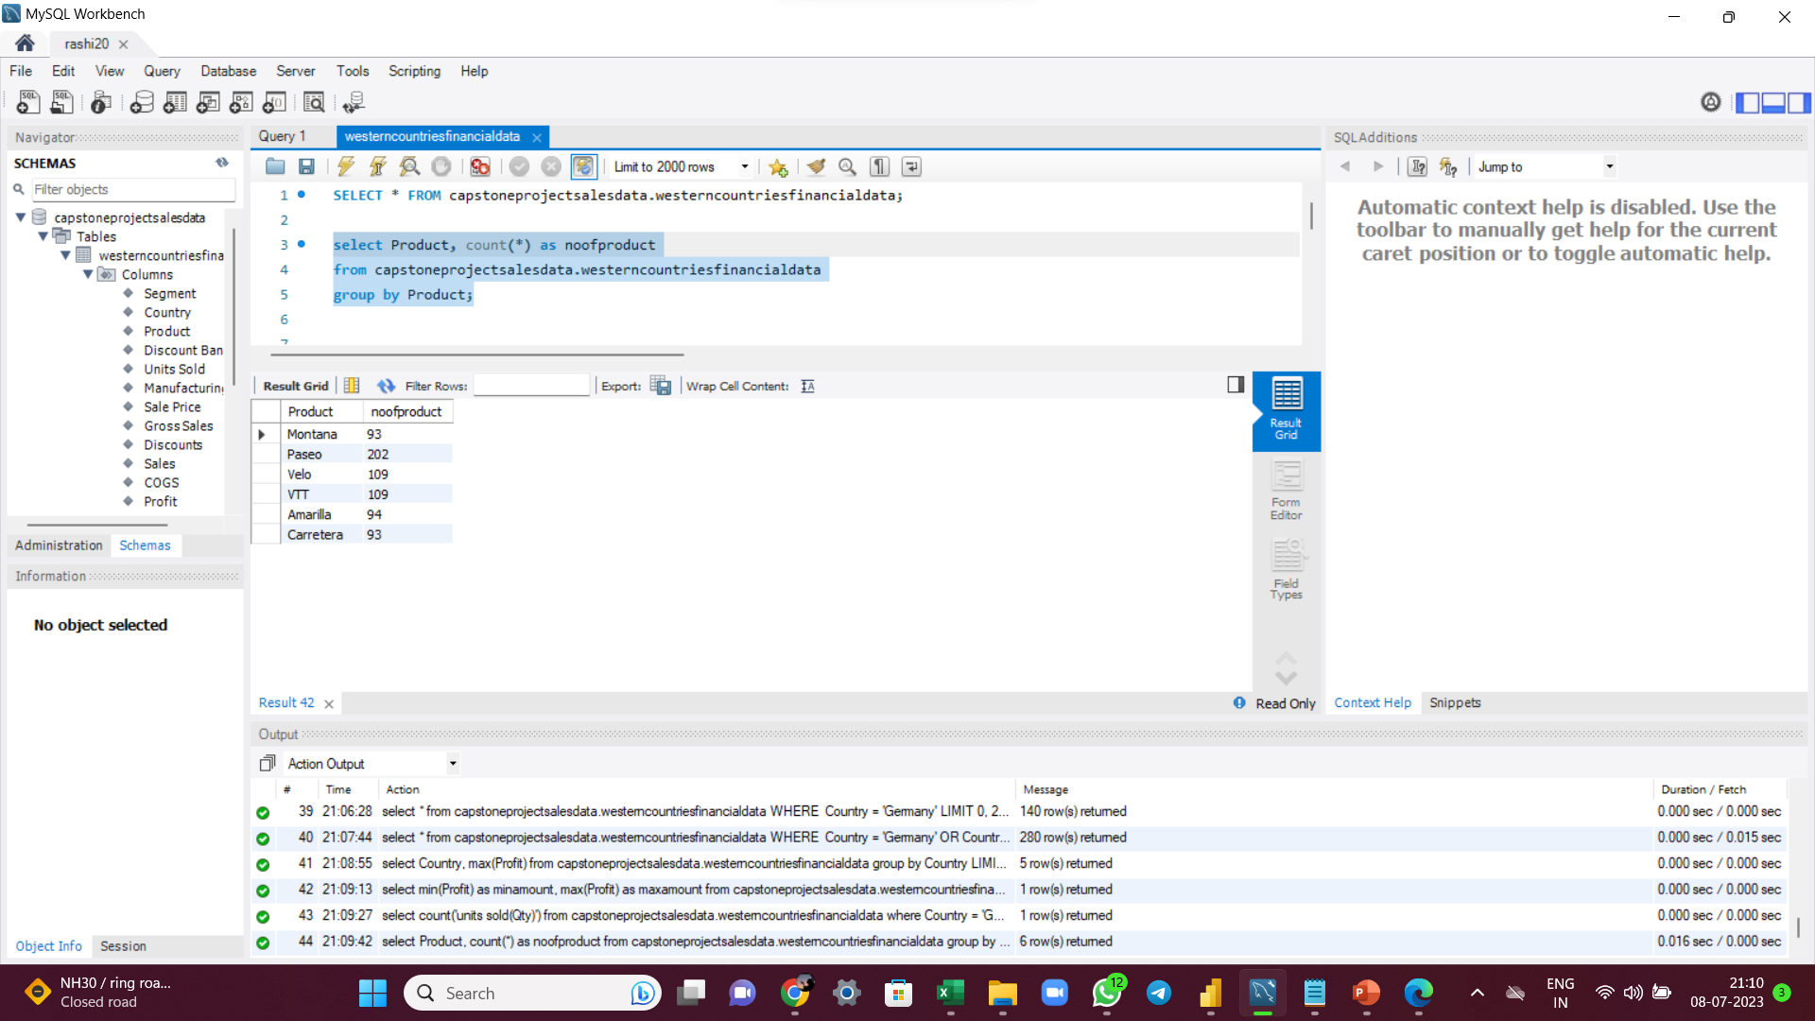
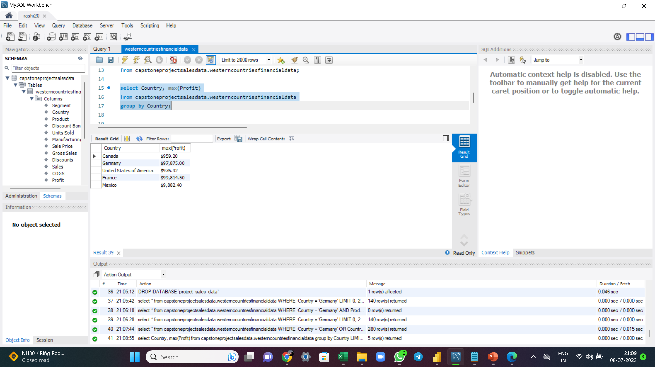
Queries(continued)

Slide 14
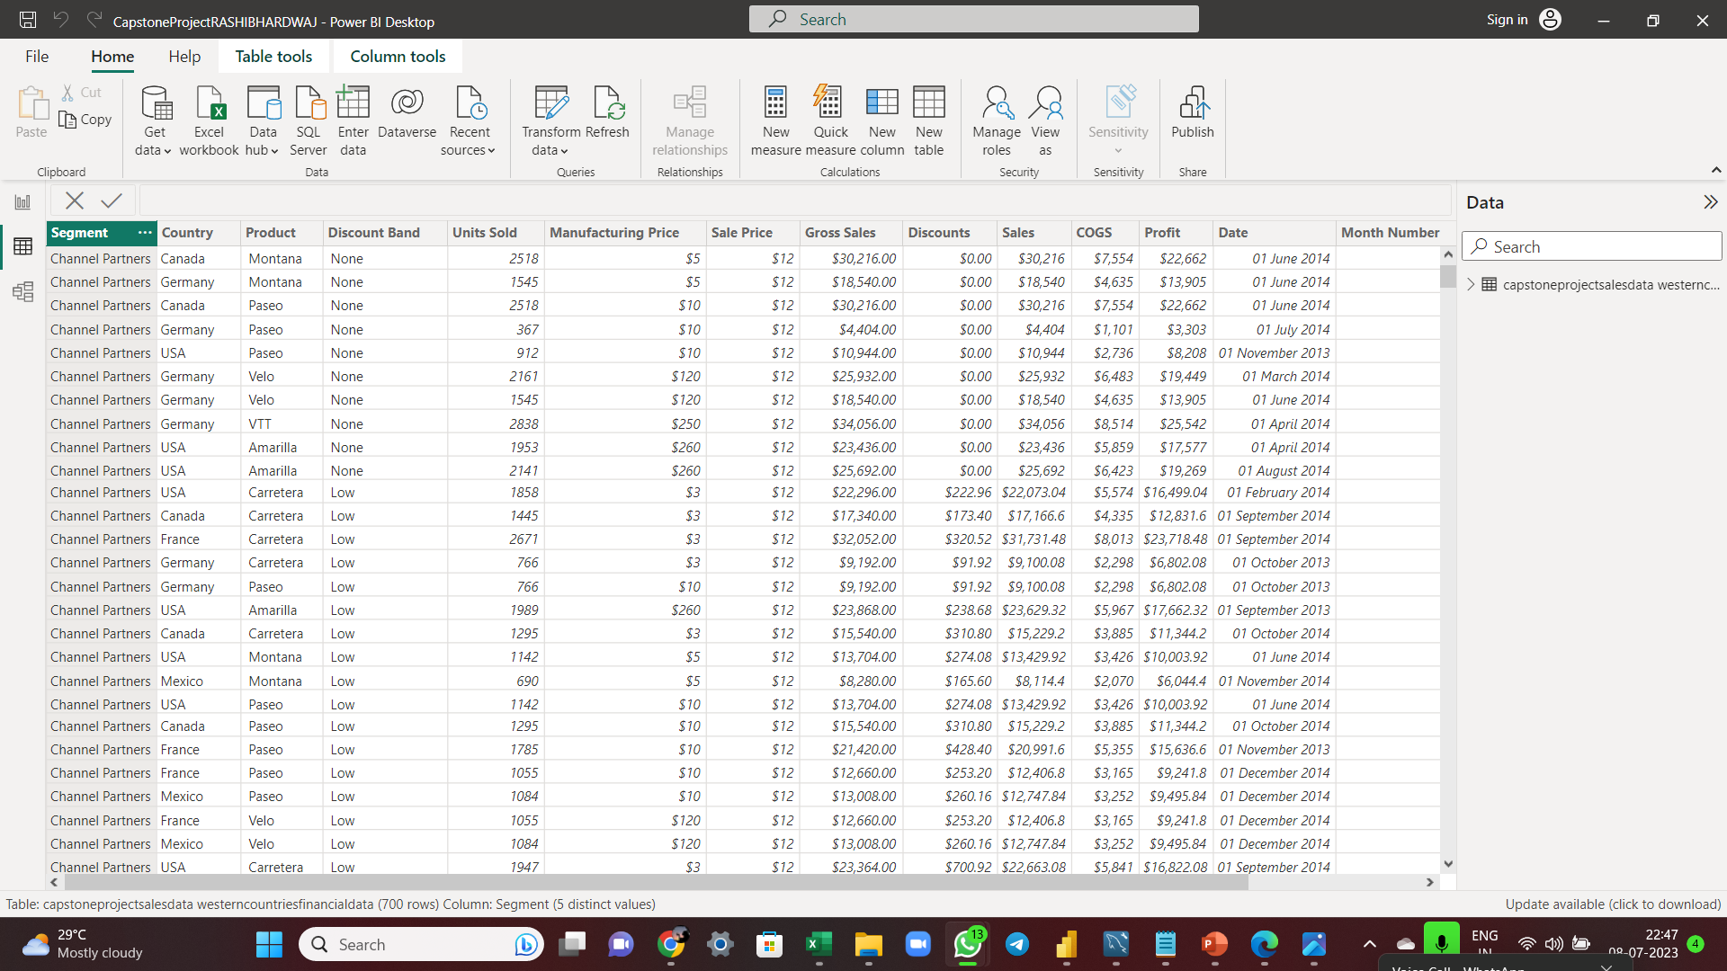
Import the Data from the SQL Database into PowerBI
Insert the relevant screenshots verifying that the data is successfully inserted into PowerBI and do the required data cleaning or creation of measures for data analysis.

Slide 15
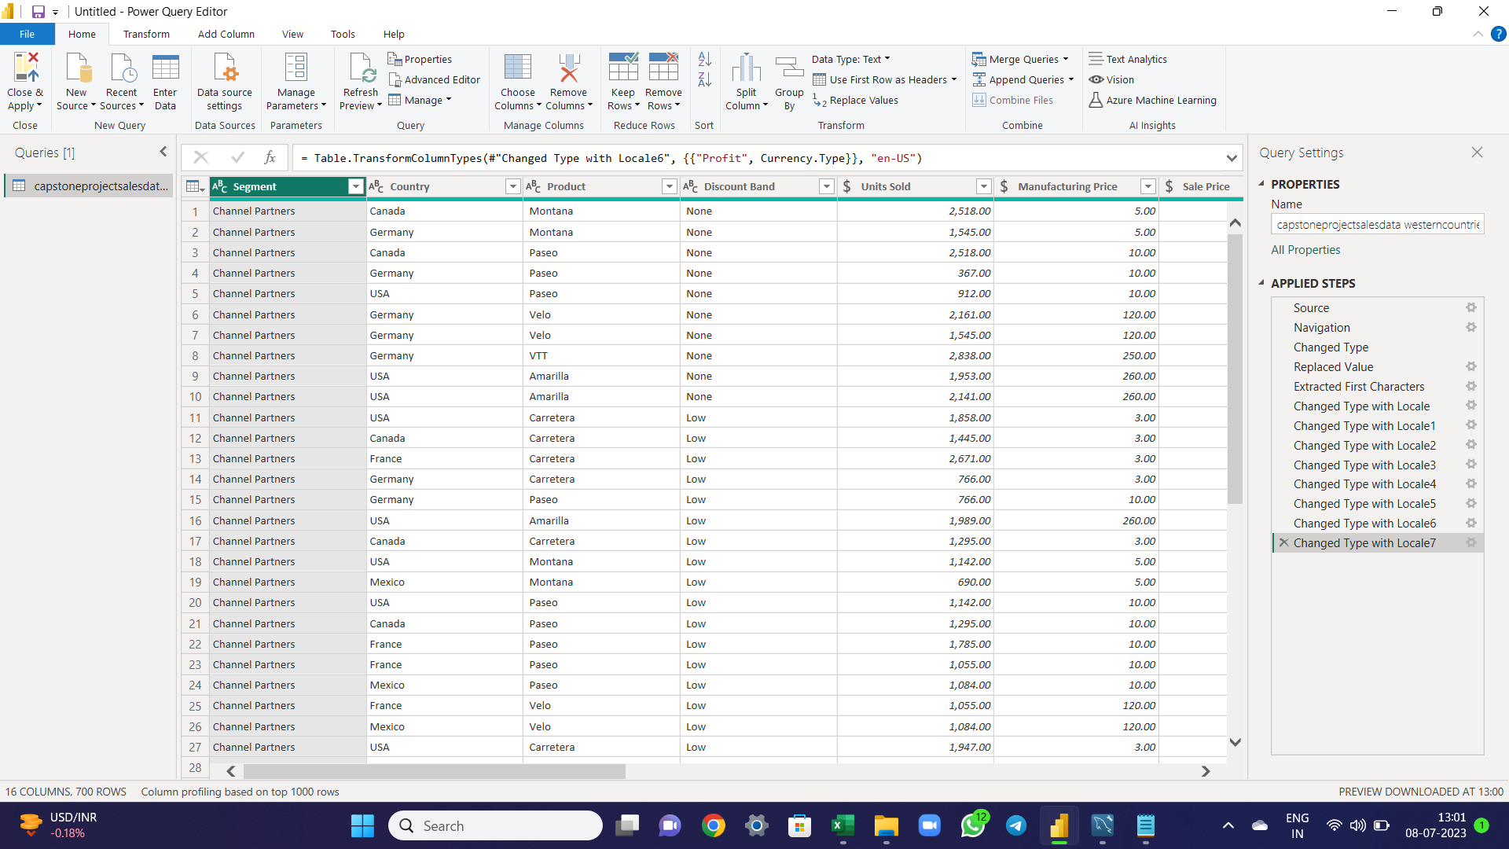
Import the Data from the SQL Database into PowerBI
Transform the data by clicking on "Transform Data" or proceed directly to Power Query Editor to update the dataset. Change the data type in all columns to align with the required data format. For instance, currency figures should include a currency symbol, letters should be represented as "abc" and numerical values should be displayed as "123." Replace occurrences of "United States of America" with "USA." Extract the first three characters from the names of the months and prepend the date calendar symbol.

Slide 16
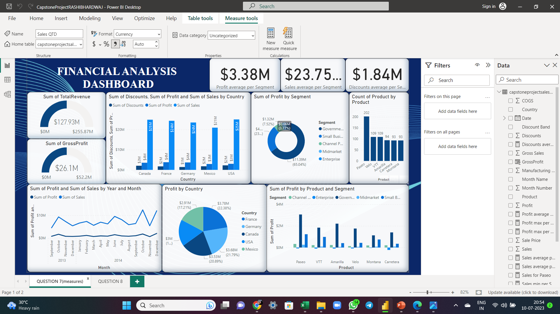
Created measures and use them to Visualize the data and make an interactive visualization.

Slide 17
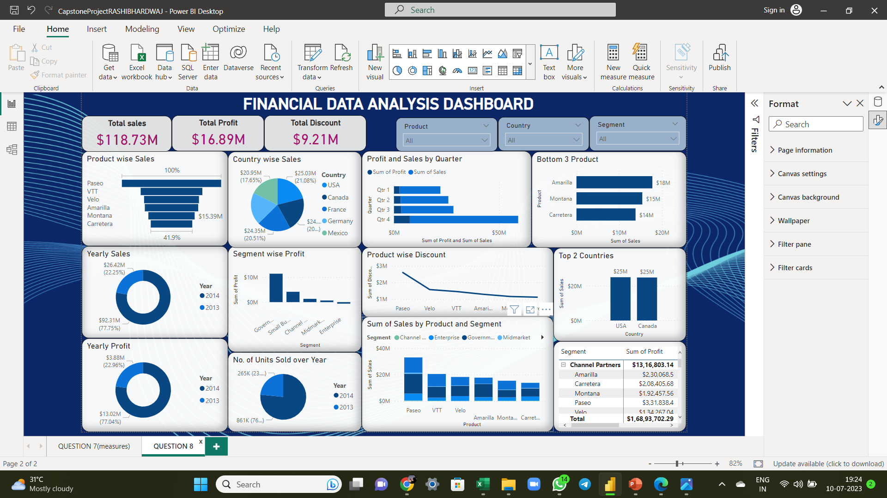
Interactive Dashboard by using visualization tools

Slide 18
Key Insights
Paseo had the highest total transactions at 202, followed by Velo and VTT tied at 109.
Paseo accounted for $15.29M of total profit.
Paseo contributed to 27.40% of the total profit in the country.
Paseo represented 16.87% of the total profit in its segment.
The government segment generated 62.84% of the total profit, while the enterprise segment had negative returns affecting the overall ROI.
France accounted for 22.38% of the total profit, being the most profitable country.
Between September 2013 and December 2014, there was a significant increase in both total sales (167.59%) and total profit (165.29%).
The sum of profit had an interesting recent trend, starting in July 2014 and rising by 119.27% in just 5 months.
During the steepest incline between July and December 2014, the profit jumped from 9,23,865.69 to 20,25,765.90.
Across all metrics, the sum of profit showed the most interesting recent trend, experiencing significant growth starting in July 2014.

Slide 19
Recommendations and Conclusion
RECOMMENDATIONS:
Enterprise is out of business with negative profits. Focus and strategic measures should be taken to minimize further losses.
Study the successful government segment to learn their strategy and marketing philosophy.
Paseo is the top-selling product across all segments and countries. Consider expanding production for higher ROI.
October showed consistently high performance when comparing 2013 and 2014.
Investigate the cause of the decline in December 2013 to avoid a recurrence.
CONCLUSION:
After analyzing the financial data, it is evident that the Paseo brand bicycle is the most profitable product for the organization, indicating the need to prioritize its production and invest in unique features for increased future profitability. On the other hand, the Carretera Premium brand bicycle is facing challenges in competing with rivals due to ineffective marketing strategies, limited brand awareness, and strong competition. To improve its performance, the brand should focus on better marketing, competitive pricing, and enhancing brand awareness within its target market.

Slide 20
Endnotes
Reference Links:-
Excel File link: CLICK HERE
Power BI File link: CLICK HERE

